Slide 1
Consumer Behavior

Slide 2
Consumer Behavior
Demand analysis starts with the behavior of the consumer
Individual consumer’s demand is derived from his utility function
Rational consumer tries to maximize his utility
Axiom of Utility Maximization
  Cardinalist Approach
  Ordinalist Approach

Slide 3
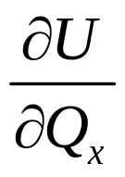
Cardinal Utility Theory
Concepts
Utility: level of happiness or satisfaction associated with alternative choices
Total utility: the level of happiness derived from consuming the good
Marginal utility: the additional utility that is received when an additional unit of a good is consumed
Change in total utility
MU=
Or
Change in quantity

Slide 4
Cardinal Utility Theory
TUx
Concepts
Qx | TUx | MUx
0 | 0 | ....
1 | 10 | 10
2 | 16 | 6
3 | 20 | 4
4 | 22 | 2
5 | 22 | 0
6 | 20 | -2
Total Utility
Quantity
MUx
Marginal Utility
Quantity

Slide 5
Diminishing Marginal Utility
As consumption of a good or service increases, the incremental (or marginal) satisfaction we get from consuming one more unit decreases.
This decrease is called the principle of diminishing marginal utility.
Law of diminishing marginal utility - marginal utility declines as more of a particular good is consumed in a given time period, ceteris paribus
Even though marginal utility declines, total utility still increases as long as marginal utility is positive. Total utility will decline only if marginal utility is negative

Slide 6
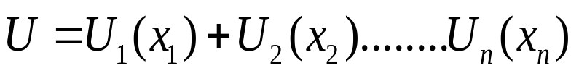
Equilibrium of the Consumer
Assumptions
  Rationality : Consumer aims at the maximization of his utility subject to constraint his income
  Cardinal Utility : Utility is measured by monetary units that the consumer is prepared to pay for another unit of the commodity
  Constant Marginal Utility of Money: Unit of measurement is that it be constant
  Diminishing Marginal Utility: The utility gained from a successive units of a commodity diminishes.
  Total Utility is Additive:

Slide 7


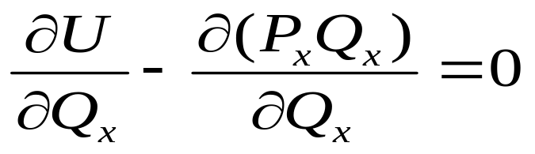
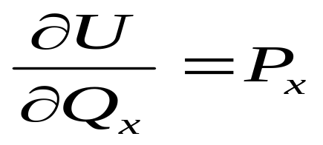
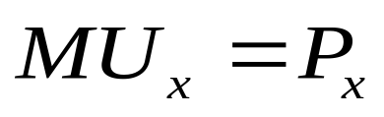
Equilibrium of the Consumer
Single Commodity Model : The consumer can either buy Commodity (x) or retain his money income (Y)
The Utility function is
If the consumer buys Qx his expenditure is PxQx
The consumer seeks to maximize the difference between his utility and expenditure
Or

Slide 8
Derivation of the Demand Curve
Condition for the equilibrium
Price
MUx
D
Marginal Utility
D
Quantity
Quantity

Slide 9
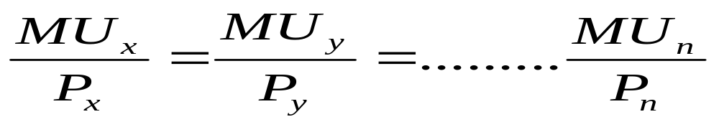
Equilibrium of the Consumer
If there are more commodities, the condition for the equilibrium of the consumer is the equality of the ratios of the marginal utilities of the individual commodities to their prices

Slide 10
Equilibrium of the Consumer
Qx | Tux | Mux | Mux/Px |  | Qy | Tuy | Muy | Muy/Py
0 | 0 | - | - |  | 0 | 0 | - | -
1 | 50 | 50 | 8.33 |  | 1 | 75 | 75 | 25.00
2 | 88 | 38 | 6.33 |  | 2 | 117 | 42 | 14.00
3 | 121 | 33 | 5.50 |  | 3 | 153 | 36 | 12.00
4 | 150 | 29 | 4.83 |  | 4 | 181 | 28 | 9.33
5 | 175 | 25 | 4.17 |  | 5 | 206 | 25 | 8.30
6 | 196 | 21 | 3.50 |  | 6 | 225 | 19 | 6.33
7 | 214 | 18 | 3.00 |  | 7 | 243 | 18 | 6.00
8 | 229 | 15 | 2.50 |  | 8 | 260 | 17 | 5.67
9 | 241 | 12 | 2.00 |  | 9 | 276 | 16 | 5.33
10 | 250 | 9 | 1.50 |  | 10 | 291 | 15 | 5.00
Suppose the price of X is 6 and price of Y is 3

Slide 11
Critique of the Cardinal Approach
Utility can not be measured objectively
Constant utility of money is unrealistic
Money can not be used as a measuring-rod since its own utility changes

Slide 12
Ordinal Utility Theory
Assumptions
  Rationality : Consumer aims at the maximization of his utility subject to constraint his income
  Ordinal Utility : Consumer can rank his preferences
  Diminishing Marginal Rate of Substitution
  Total Utility is Additive
  Consistency and transitivity of choice
  If A > B then B ≯ A
  If A > B, and B > C, then A > C

Slide 13
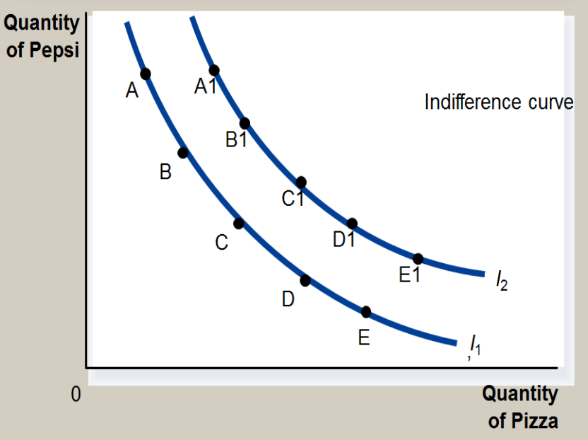
Preferences: What the Consumer Wants
A consumer’s preference among consumption bundles
Case 1 |  |  | Case 2
 | Pizza (X) | Pepsi (Y) |  | Pizza (X) | Pepsi (Y)
A | 1 | 12 | A1 | 2 | 24
B | 2 | 8 | B1 | 4 | 16
C | 3 | 5 | C1 | 6 | 10
D | 4 | 3 | D1 | 8 | 6
E | 5 | 2 | E1 | 10 | 4
A consumer’s preference among consumption bundles may be illustrated with indifference curves.

Slide 14
Representing Preferences with Indifference Curves
The Consumer’s Preferences
  The consumer is indifferent, or equally happy, with the combinations shown at points A, B, and C because they are all on the same curve.
The Marginal Rate of Substitution
  The slope at any point on an indifference curve is the marginal rate of substitution.
    It is the rate at which a consumer is willing to trade one good for another.
    It is the amount of one good that a consumer requires as compensation to give up one unit of the other good.

Slide 15
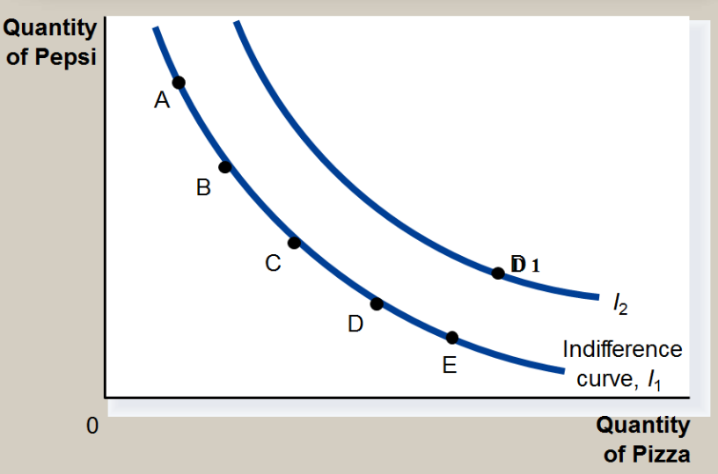
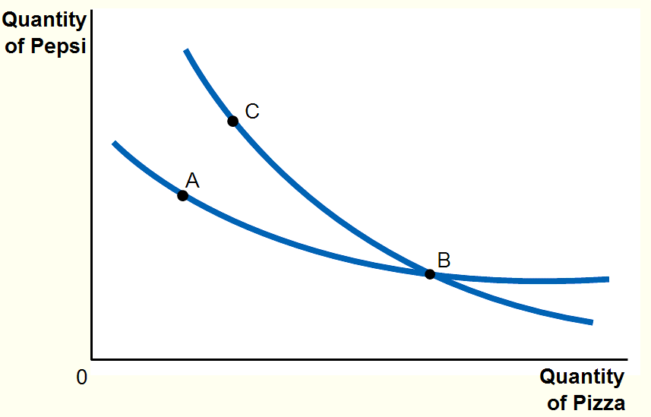
Properties of Indifference Curves
Higher indifference curves are preferred to lower ones.
Indifference curves do not cross.
Indifference curves are downward sloping and convex to the origin.

Slide 16
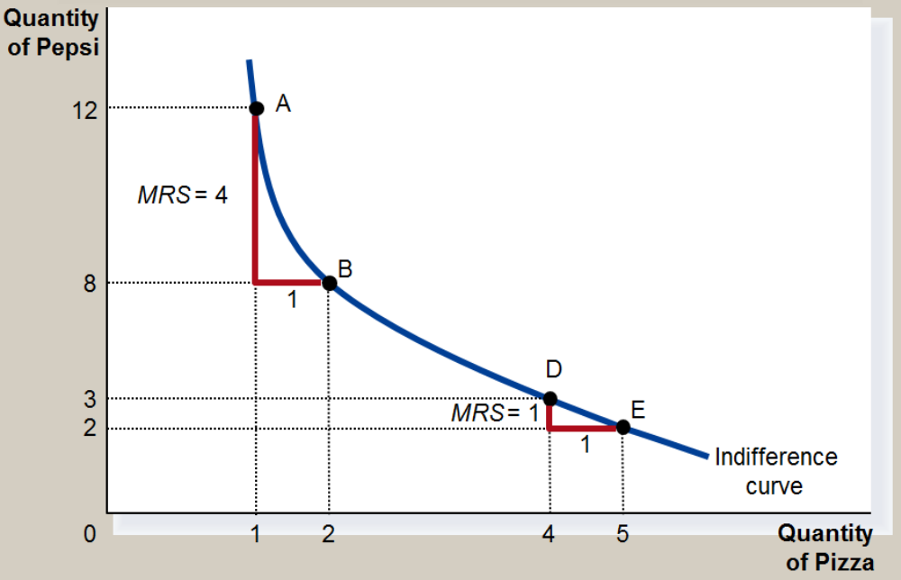
Properties of Indifference Curves
Marginal Rate of Substitution
 | Pizza (X) | Pepsi (Y) | MRSxy
A | 1 | 12 | ---
B | 2 | 8 | 4
C | 3 | 5 | 3
D | 4 | 3 | 2
E | 5 | 2 | 1
Diminishing marginal rate of substitution: The rate of substitution declines as consumption for X per unit increases

Slide 17
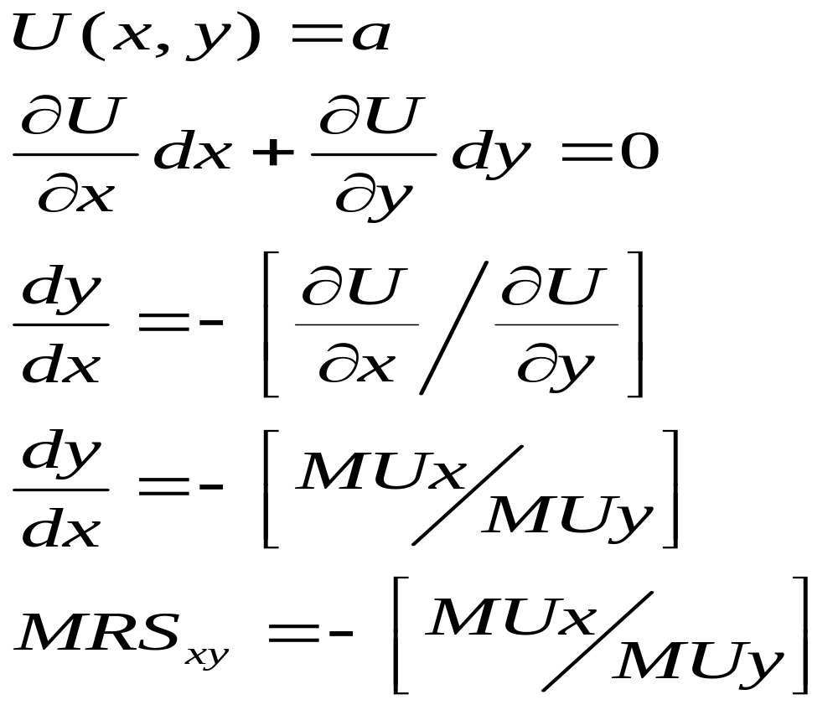
Relationship between MRS and MU

Slide 18
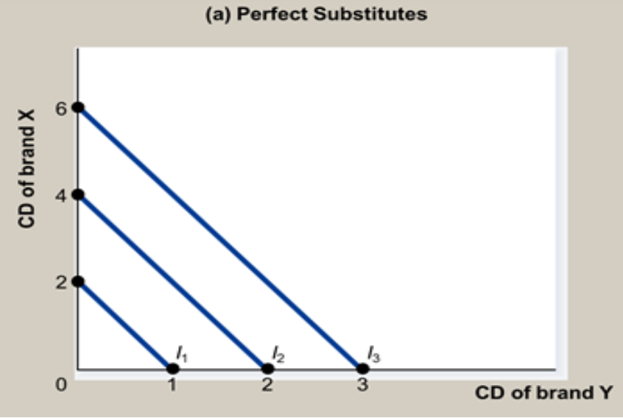
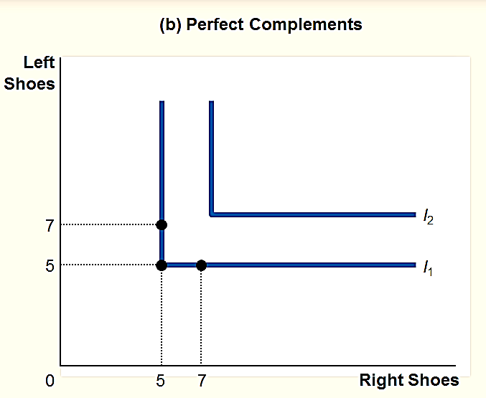
Two Extreme Examples of Indifference Curves
Perfect substitutes
  Two goods with straight-line indifference curves are perfect substitutes.
  The marginal rate of substitution is a fixed number.
Perfect complements
  Two goods with right-angle indifference curves are perfect complements.

Slide 19
The Budget Constraint: What the Consumer Can Afford
The budget constraint depicts the limit on the consumption “bundles” that a consumer can afford.
  People consume less than they desire because their spending is constrained, or limited, by their income.
The budget constraint shows the various combinations of goods the consumer can afford given his or her income and the prices of the two goods.

Slide 20
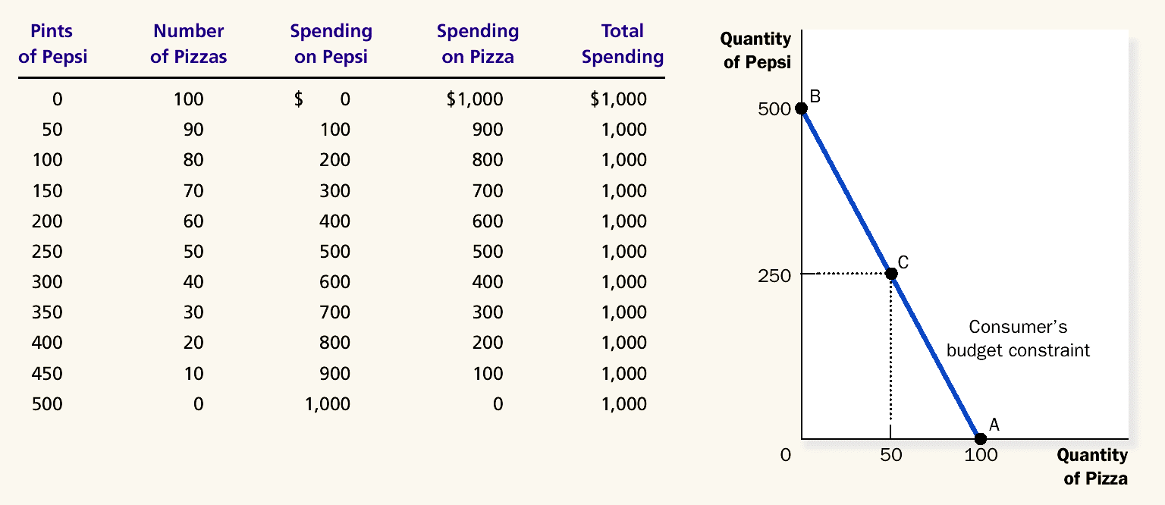
The Consumer’s Budget Constraint
Assuming Per unit price of Pepsi 2 and Per unit Price of Pizza 10

Slide 21
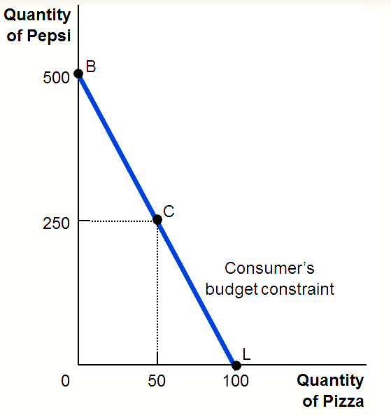
The Budget Constraint: What the Consumer Can Afford
The Consumer’s Budget Constraint
  Any point on the budget constraint line indicates the consumer’s combination or tradeoff between two goods.
  For example, if the consumer buys no pizzas, he can afford 500 pints of Pepsi (point B). If he buys no Pepsi, he can afford 100 pizzas (point L).
  Alternately, the consumer can buy 50 pizzas and 250 pints of Pepsi.

Slide 22
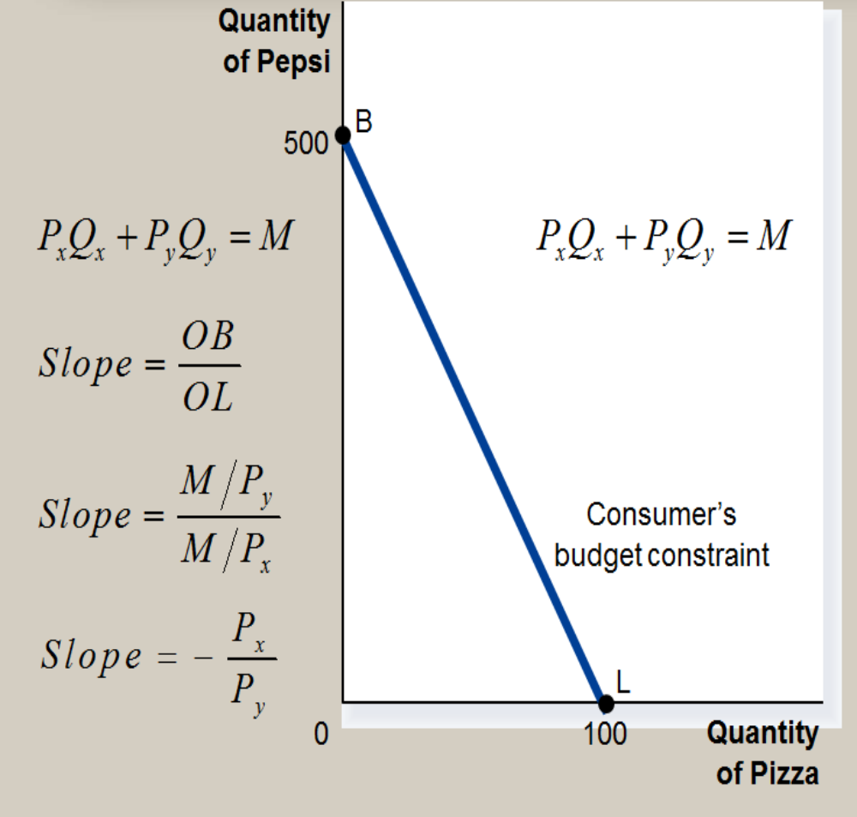
The Budget Constraint: What the Consumer Can Afford
The slope of the budget constraint line equals the relative price of the two goods, that is, the price of one good compared to the price of the other.
It measures the rate at which the consumer can trade one good for the other.

Slide 23
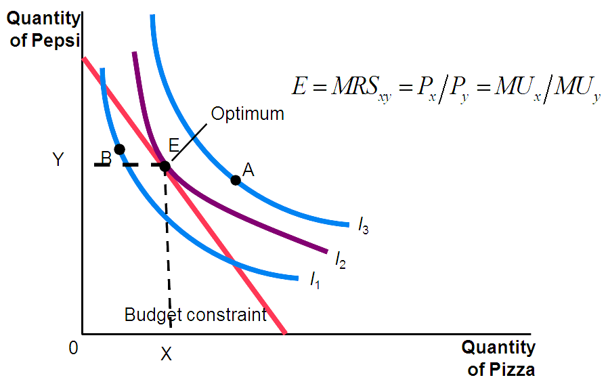
Optimization: What The Consumer Chooses
Consumers want to get the combination of goods on the highest possible indifference curve.
However, the consumer must also end up on or below his budget constraint.

Slide 24
The Consumer’s Optimal Choices
Combining the indifference curve and the budget constraint determines the consumer’s optimal choice.
Consumer optimum occurs at the point where the highest indifference curve and the budget constraint are tangent.
The consumer chooses consumption of the two goods so that the marginal rate of substitution equals the relative price.

Slide 25
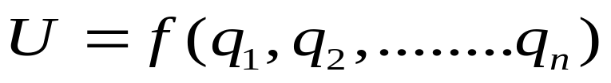
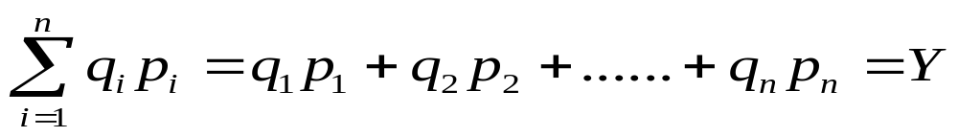

Mathematical Derivation of the Equilibrium
Given the market prices and his income, the consumer aims at the maximization of his utility.
Maximize
Subject to
Rewrite the constraint in the form
Multiply the constraint by a constant which is Lagrangian multiplier

Slide 26
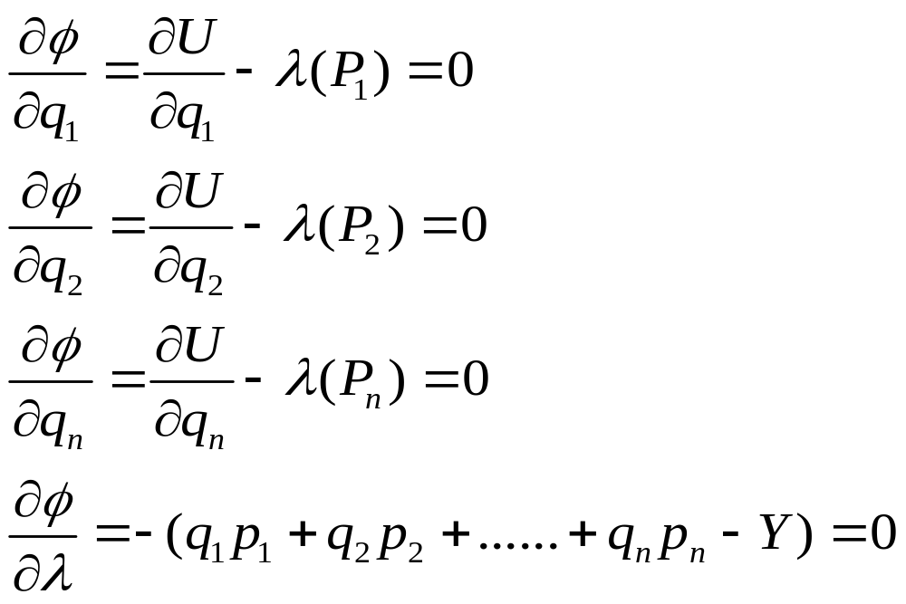
Mathematical derivation of the Equilibrium
Composite function
Differentiating the composite function with respect to q1, q2….qn
……… 1
……… 2
……… 3
..4

Slide 27
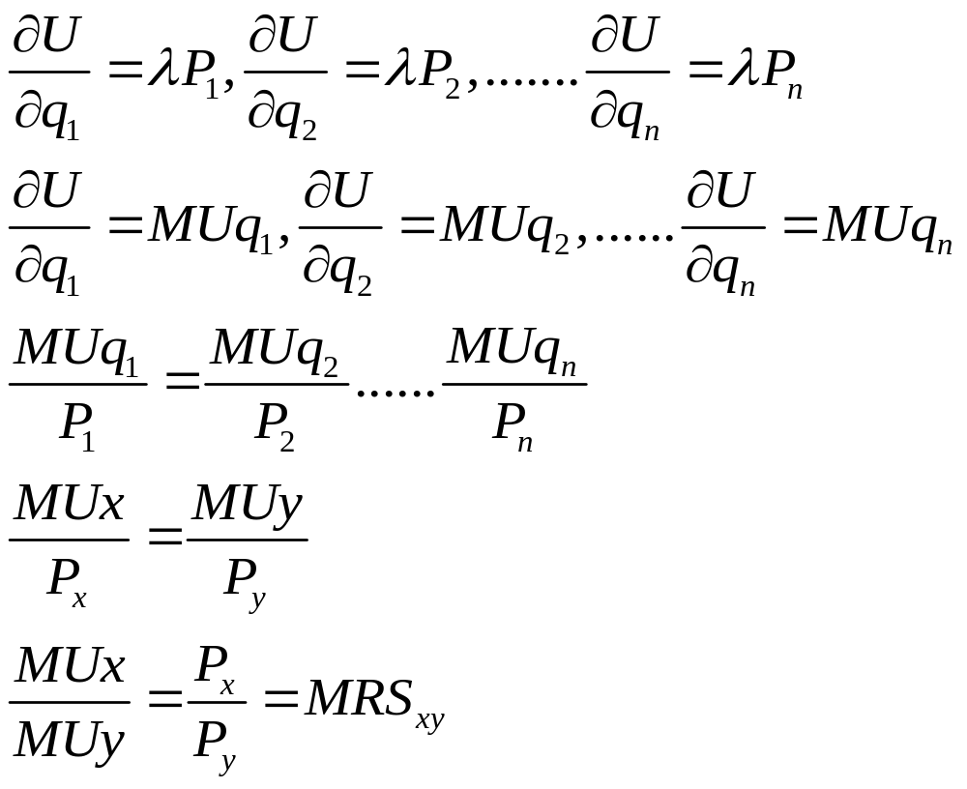
Mathematical derivation of the Equilibrium
Solving EQ1…EQ2….
EQ3
Equilibrium condition

Slide 28
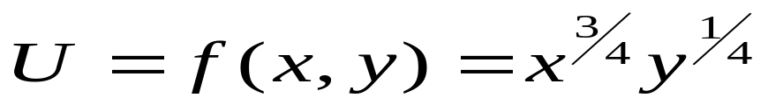

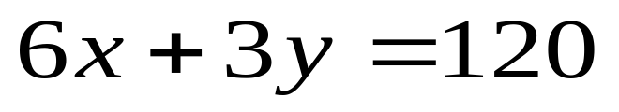
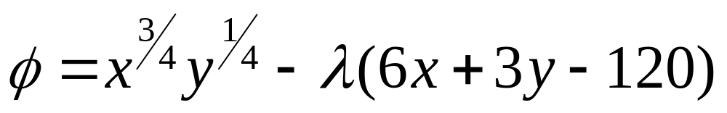
Mathematical derivation of the Equilibrium
Example
Utility function of an consumer is given by
. Find out the optimal quantity of the two goods , if price of x is Rs 6/- per unit and price of y is Rs 3/- per unit and the income of the consumer is Rs 120/-
Solution
Maximize
Subject to
Composite function
Ans: x = 15 and y = 10

Slide 29
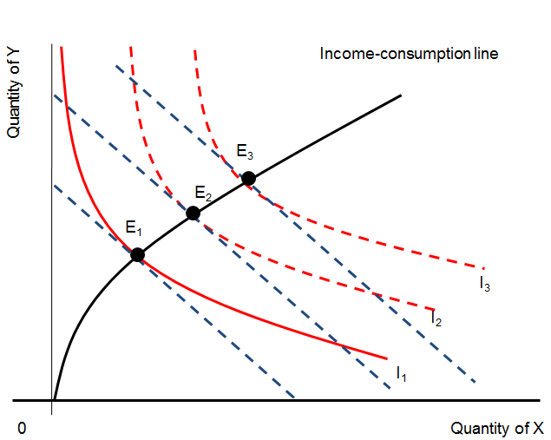
How Changes in Income Affect the Consumer’s Choices
How a consumer’s purchases react to changes in income with relative prices held constant
Income-consumption Line
    Increases in income shift the budget line out parallel to itself, moving the equilibrium from E₁ to E₂ to E₃.
    The income-consumption line joins all these points of equilibrium.
    If a consumer buys more of a good when his or her income rises, the good is called a normal good.
    If a consumer buys less of a good when his or her income rises, the good is called an inferior good.

Slide 30
How Changes in Price of a Commodity Affect the Consumer’s Choices
The Price-consumption Line
a
Price-consumption
line
Quantity of Y
E₁
E₂
E₃
I₃
I₂
I₁
o
Q1
b
Q2
Q3
c
d
Quantity of X

Slide 31
The Price-consumption Line
    This line shows how a consumer’s purchases react to a change in one price, with money income and other prices held constant.
    Decreases in the price of food (with money income and the price of clothing constant) pivot the budget line from ab to ac to ad.
    The equilibrium position moves from E₁, to E₂ to E₃.
    The price-consumption line joins all such equilibrium points.
Price | BL | IC | Equilibrium | Qx
P1 | ab | IC1 | E1 | OQ1
P2 | ac | IC2 | E2 | OQ2
P3 | ad | IC3 | E3 | OQ3

Slide 32
Derivation of an Individual’s Demand Curve
Derivation of an Individual’s Demand Curve
Price | BL | IC | Equilibrium | Qx
P1 | ab | IC1 | E1 | OQ1
P2 | ac | IC2 | E2 | OQ2
P3 | ad | IC3 | E3 | OQ3
a
Quantity of Y
Price-consumption line
E₂
E₁
E₀
I₂
I₀
I₁
b
c
d
0
Q1
Q2
Q3
Quantity of X
Price of X
P1
x
y
P2
Demand curve
P3
z
0
Q1
Q2
Q3
Quantity of X

Slide 33
Price Effect = Income Effect + Substitution Effect
A Change in Price: Substitution Effect
  A price change first causes the consumer to move from one point on an indifference curve to another on the same curve.
    Illustrated by movement from point A to point B.
A Change in Price: Income Effect
  After moving from one point to another on the same curve, the consumer will move to another indifference curve.
    Illustrated by movement from point B to point C.

Slide 34
Changes in a Good’s Price
Suppose the consumer is maximizing
utility at point A.
Quantity of y
If the price of good x falls, the consumer
will maximize utility at point B.
B
A
U2
U1
Quantity of x
Total increase in x

Slide 35
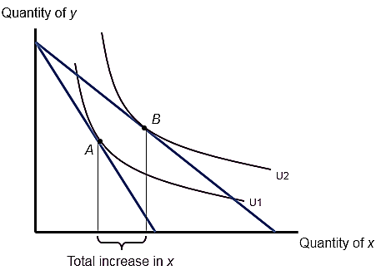
Changes in a Good’s Price
To isolate the substitution effect, we hold
“real” income constant but allow the
relative price of good x to change
Quantity of y
The substitution effect is the movement
from point A to point C
A
C
U1
Quantity of x
Substitution effect
The individual substitutes good x for good y
because it is now relatively cheaper

Slide 36
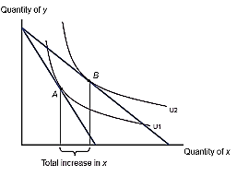
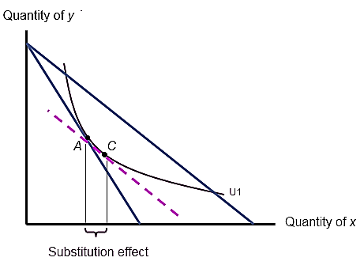
Changes in a Good’s Price
The income effect occurs because the
individual’s “real” income changes when
the price of good x changes
Quantity of y
The income effect is the movement
from point C to point B
B
A
C
U2
U1
Quantity of x
Income effect
If x is a normal good, the individual will buy more because “real” income increased

Slide 37
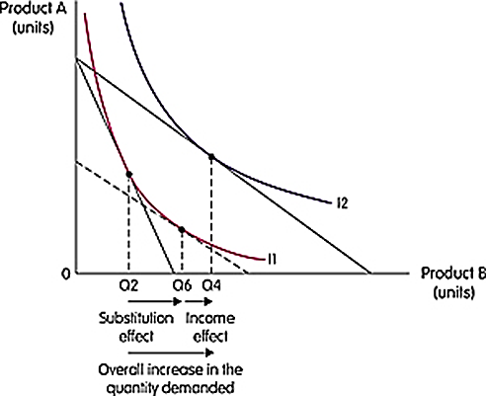
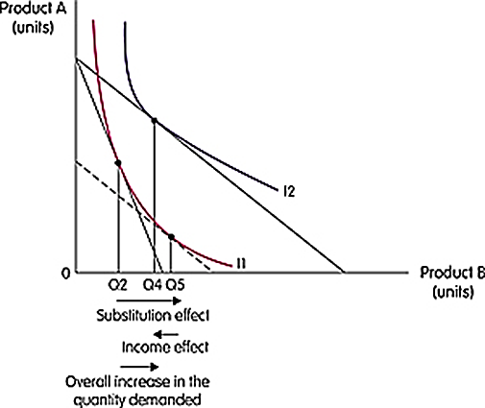
Price Effect = Income Effect + Substitution Effect
Normal good
The substitution effect is always negative
The income effect is positive for normal goo
If a good is normal, substitution and income effects reinforce one another
  when price falls, both effects lead to a rise in quantity demanded
  when price rises, both effects lead to a drop in quantity demanded
Inferior goods
The substitution effect is always negative,
The income effect is negative for inferior good
If a good is inferior, substitution and income effects move in opposite directions
The combined effect is indeterminate
  when price rises, the substitution effect leads to a drop in quantity demanded, but the income effect is opposite
  when price falls, the substitution effect leads to a rise in quantity demanded, but the income effect is opposite

Slide 38
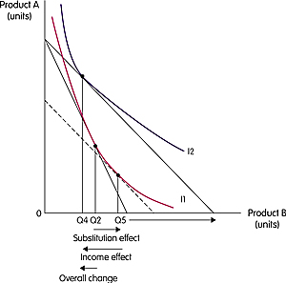
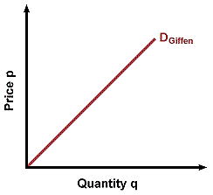
Price Effect = Income Effect + Substitution Effect
Giffen goods
The substitution effect is always negative,
The income effect is negative for inferior goods
If the income effect of a price change is strong enough, there could be a positive relationship between price and quantity demanded
  an increase in price leads to a drop in real income
  since the good is inferior, a drop in income causes quantity demanded to rise
  The most commonly cited example of a Giffen good is that of the Irish potato famine in the 19th century. During the famine, as the price of potatoes rose, impoverished consumers had little money left for more nutritious but expensive food items like meat (the income effect). So even though they would have preferred to buy more meat and fewer potatoes (the substitution effect), the lack of money led them to buy more potatoes and less meat. In this case, the income effect dominated the substitution effect, a characteristic of a Giffen good.

Slide 39
